Slide 1

MSE 311: Thermodynamics of Materials
Lecture-01:
Introduction
2022 Fall
Weishu Liu
Department of Materials Science and Engineering
Southern University of Science and Technology (SUSTech)
Email: liuws@sustech.edu.cn
Office: North Tower, Rm310#

Slide 2
Introduction
Weishu Liu (刘玮书）, Full Professor, MSE Department
Phone：755-88018955(O); 18211421630(C）
Office：Room 310, Room 310, North Tower, Email: liuws@sustech.edu.cn
Website：http://mse.sustc.edu.cn/cn/people/detail/id/81
Educational Background：
Ph.D. in MSE, University of Science and Technology Beijing (USTB), 2009
B.Eng. in Inorganic Materials, Chongqing University, 2003
Professional Experience：
09/2016– present: SUSTC/Dept. of MSE
02/2015– 08/2016: Principal Materials Scientist, Sheetak. Inc
01/2013– 1/2015: Res. Assis. II, University of Houston
12/2009-12/2012: Post Doc, Boston Collage
01/2009-11/2009: Post Doc, University of Washington
Teacher Assistant: Xinzhi Wu
Office：Room 335, North Tower

Slide 3
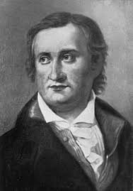
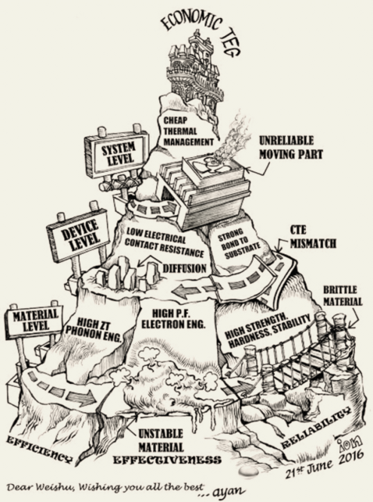
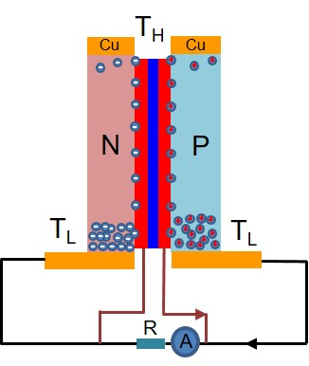
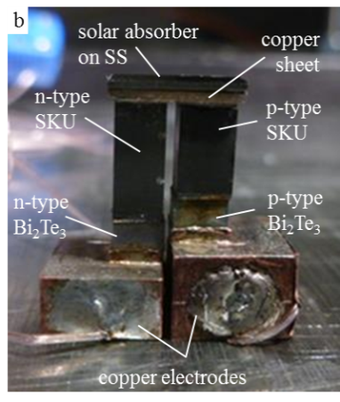
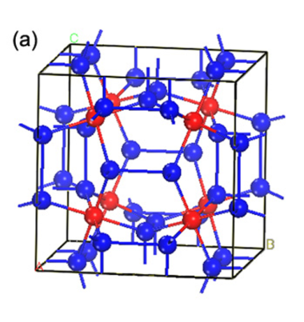
My research version
Thermoelectric
effect
Therm to electric
Electrons
Ions
Electric domain
….
T. J. Seebeck
Thermoelectric
Materials
Thermoelectric
Devices
Thermoelectric
Mountain
Going beyond
Seebeck Effect
PhD
2003-2009
Post Doc
2009-2015
Industry
2015-2016
SUSTech
2016-Now

Slide 4
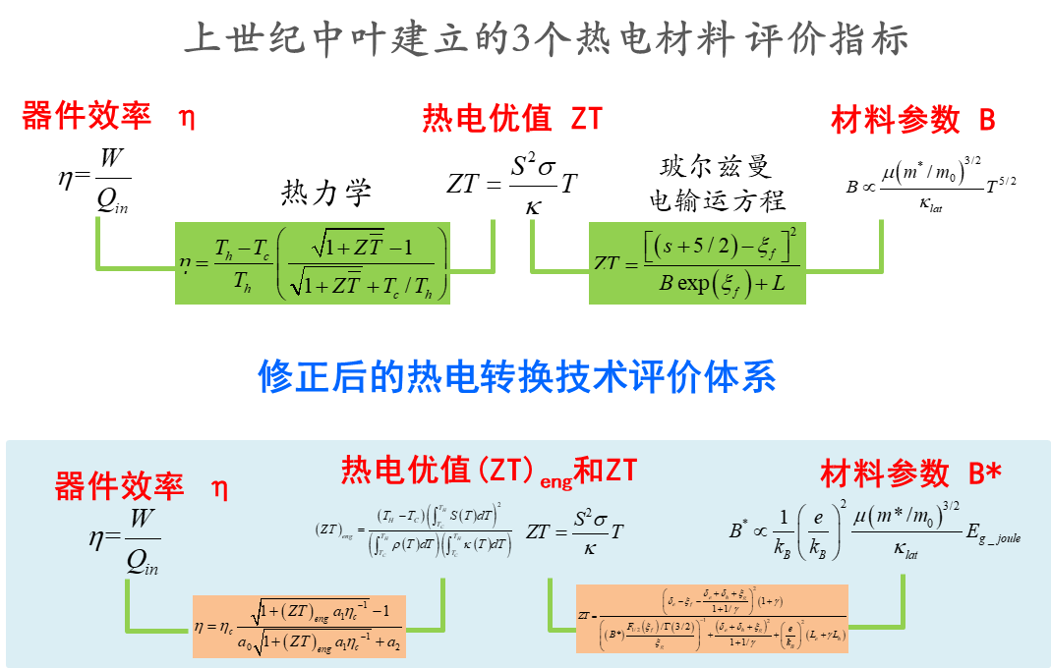
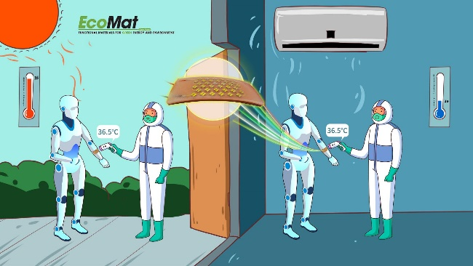
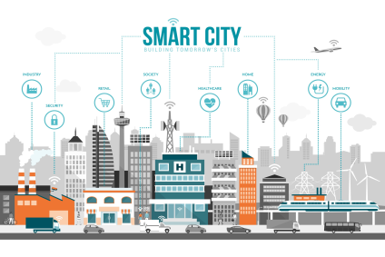
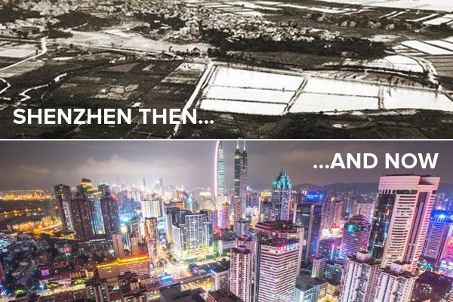
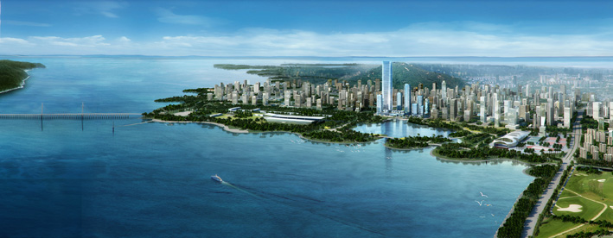
My research topic
Thermal energy harvest from envrionment for IoT
E-Skin for robotics
Material & System
Pictures from internet

Slide 5
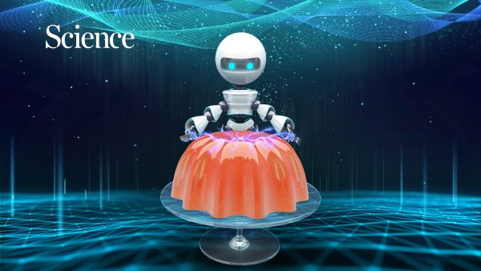
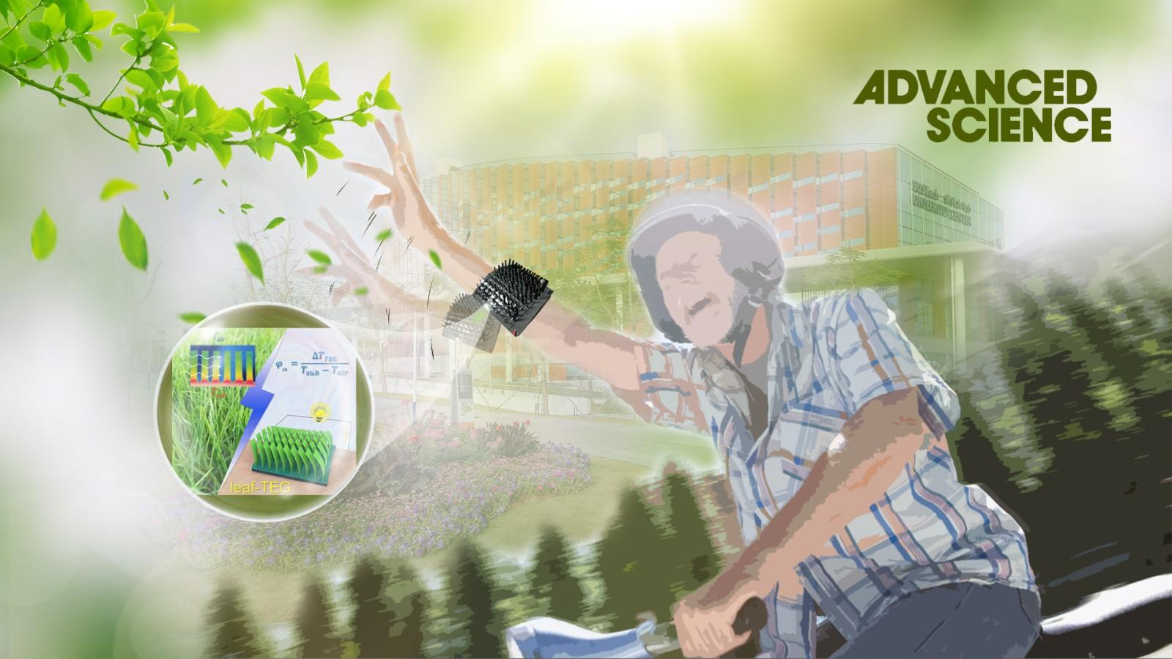
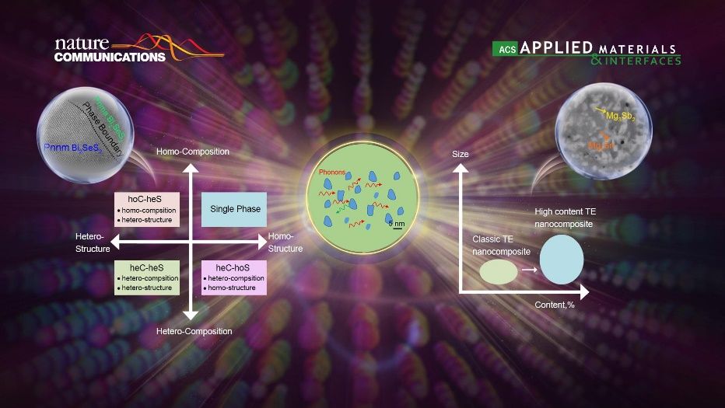
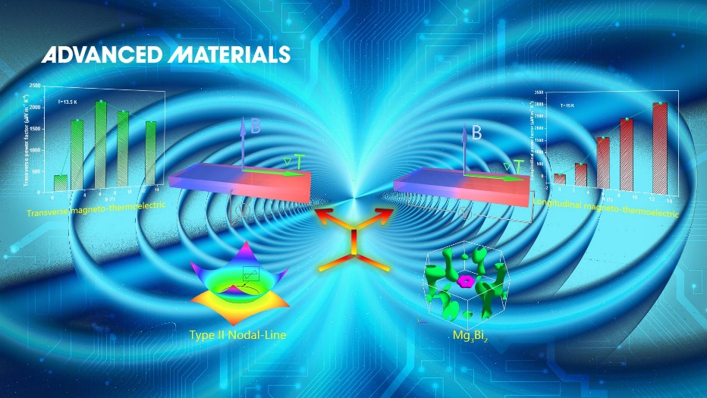
Selected works

Slide 6

What’s the thermodynamics

Slide 7
Classic Thermodynamics
The term thermodynamics is related to the two Greek words
therme ： heat
dynamikos ：power
Thermodynamics is the physical science that focuses on the relationship between energy and work as well as the equilibrium states and variables of systems that are being investigated.
Thermodynamics deals with the conservation of energy as well as the conversion of the various forms of energy into each other or into work

Slide 8
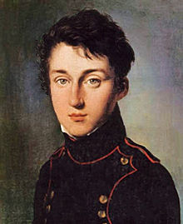
Classic Thermodynamics
Thermodynamics developed out of a desire to increase the efficiency of early steam engines
Carnot had two key questions about heat engines he wanted to answer:
Was the work available from a heat source unlimited?
And can the efficiency of heat engines be improved by replacing steam with a different fluid or gas?
Carnot died during a cholera epidemic that swept Paris in 1832, at the age of 36. Fearing they were contaminated, many of his writings were buried with him at his funeral—very little was saved
His ideas were incorporated into the thermodynamic theories proposed by Rudolf Clausius and William Thomson in the early 1850s.
Rudolf Diesel also drew on Carnot's theories when he designed the diesel engine in 1893.
Nicolas L. Sadi Carnot
French
(1796-1832)
With his multiple scientific contributions… Nicolas Léonard Sadi Carnot is often described as the “Father of Thermodynamics.

Slide 9
Classic Thermodynamics
Thermodynamics
It is not only about the Engine, but almost everything !!!
it is about the energy and its transforms
it is concerned with the behavior of matter
it is the science of the impossible
it is only concerned with large scale observations

Slide 10
Laws of Thermodynamics
Zeroth Law of thermodynamics:
If two systems are each in thermal equilibrium with a third, they are also in thermal equilibrium with each other.
First Law of thermodynamics
The internal energy of an isolated system is constant
Second Law of thermodynamics
Heat cannot spontaneously flow from a colder location to a hotter location
Third Law of thermodynamics
As a system approaches absolute zero, all processes cease and the entropy of the system approaches a minimum value

Slide 11
Application
The conservation of energy
The limit of efficiency
Carnot Efficiency:
The increase of entropy
Q_{H}
Q_{c}
Heat Source
Heat
Engine
Cold
Sink
W

Slide 12
Laws of Thermodynamics
They is universally valid
They have been confirmed (not proven)
to a very high degree of confidence
There is now so much supporting evidence that we can accept them as accurate. So far, reliable and reproducible contradictory evidence has not happen !

Slide 13
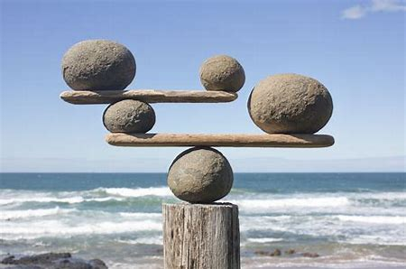
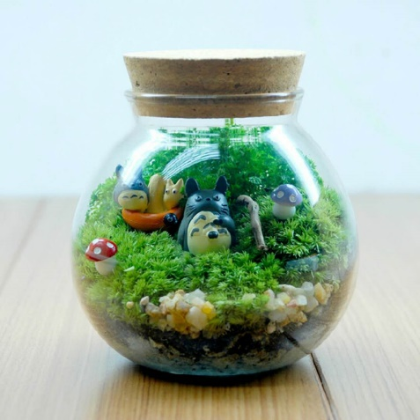
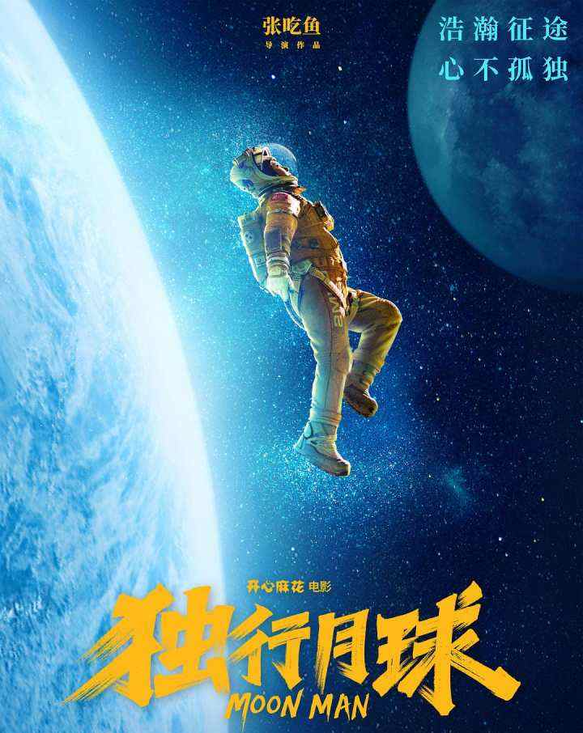
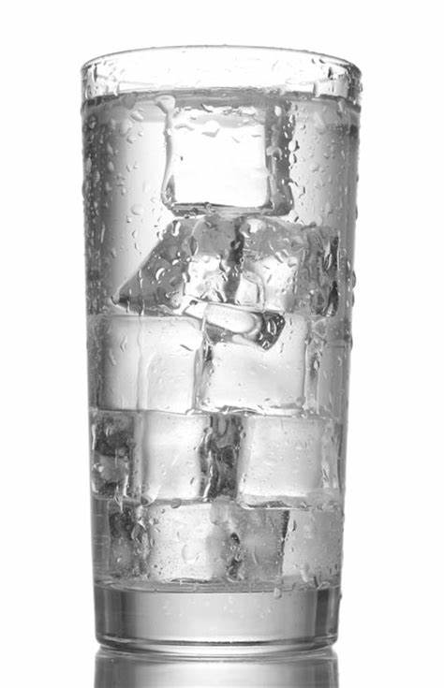
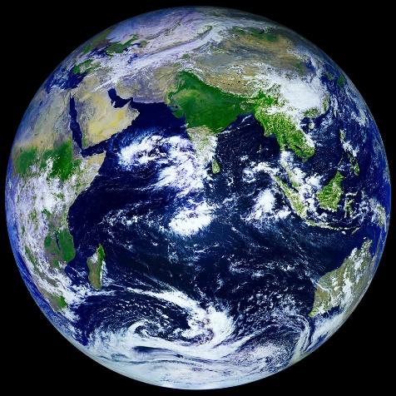
Discussion
The importance of Equilibrium
Mechanical equilibrium, thermal equilibrium, eco equilibrium, earth equilibrium…

Slide 14
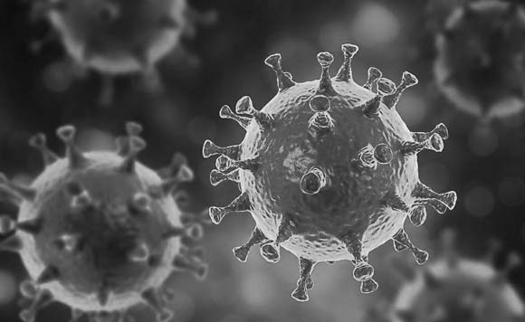
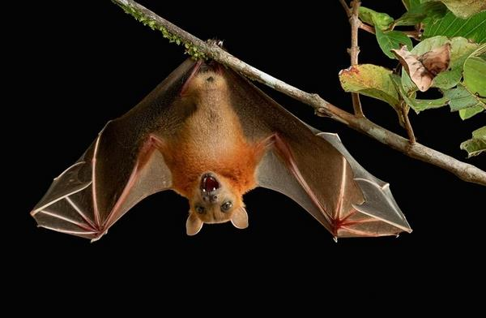
Discussion
The importance of Equilibrium
Coronavirus
Bats
Equilibrium is broken as it get into Human being!

Slide 15
The scope of thermodynamics and kinetics
Thermodynamics and kinetics
Thermodynamics: the relationships in equilibrium state
Kinetics: the process from one equilibrium state to another
Phenomenological, Statistical, and Quantum Descriptions
Classic Thermodynamics
Statistical Thermodynamics
Quantum Descriptions

Slide 16
The scope of MSE311
Energy
Internal energy
Work
Heat
Classic thermodynamics
Statistical thermodynamics
Material Thermodynamics & Kinetics
--- Solution TD
--- Phase diagram TD.
--- Diffusion TD.
--- Crystal Growth
--- Ceramic Sintering
--- Polymer mixing
Mater
Gas
Liquid
Solid

Slide 17
Contents of this course
History of thermodynamics
Classic thermodynamics
Statistical thermodynamics
Solutions
Phase diagram
Growth/Sintering/Mixing

Slide 18
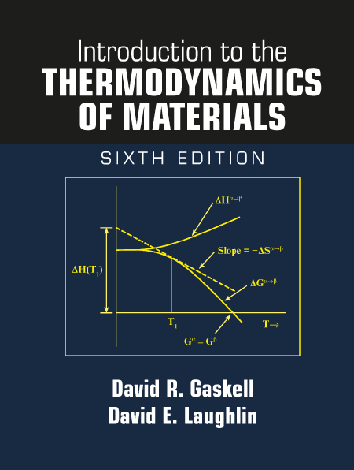
Reference Books
Text books:
Introduction to the thermodynamics of materials, 5th，6th edition, by David R. Gaskell, Talor & Francis Press, 2018
材料热力学和动力学，赵新兵，浙江大学出版社，2016
热力学，王竹溪，北京大学出版社
Reference Books
Thermodynamics in Materials Science, 2nd edition, by Robert Dehoff, Talor & Francis Press, 2006
Thermodynamics: an engineering approach, 8th Edition, by Yuunus A. Cengel and Michael A. Boles, McGraw Hill Education, 2011
Computational thermodynamics of mateials, Zikui Liu and Yi Wang, Cambridge, 2016.
微观组织热力学，西泽态二著，郝世明译，化学工业出版社，2006
材料热力学，郝士明，蒋敏，李洪晓， 化工出版社， 2020
材料热力学与动力学， 徐瑞，哈尔滨工程大学，2021
烧结实践与科学原理，兰德尔·杰曼著，贾成厂译，化学工业出版社，2021

Slide 19
Objectives
Master the fundamental laws of thermodynamics
Familiarize with classical and some statistical approaches
Understand the thermal behavior of gases and solutions
Master phase diagram
Use thermodynamics to predict and interpret phase equilibria
Use thermodynamics to explain and understand various interface phenomena related to energy

Slide 20
Distribution of scoring:
Class participation: 15%
There will be about 10-12 quizzes at beginning of classes (not every class)
5 conceptual/simple calculation questions for 10-20 minutes
Turn in on time will get 50% credit
Homework: 25 %
Out of class assignments will be given throughout the course.
The assignments include 2 lecture essays related to the open questions, the excellent lecture essay could get extra score! Each essays should be finished independently! The length of each essays should be > 1000 words !
Homework must be turned at beginning of the following classes:
Turn in paper homework to TA by person;
Turn in homework on time will get 50% credit;
Hand in homework to TA by Friday 5pm is acceptable, but lose 50% credit;
After Friday 5pm, no accepted.
Midterm: 30%
Final: 30%

Slide 21
1. Temperature and Scale
Chapter1：
热力学，王竹溪，北京大学出版社

Slide 22
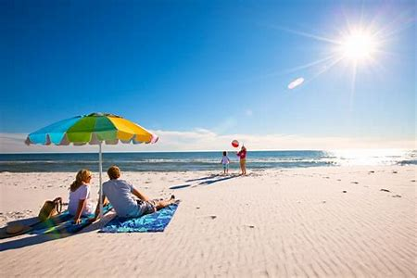
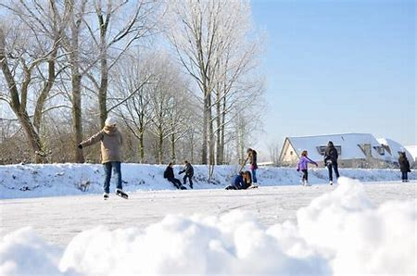
Early experience in temperature change
Our experience to the hot and cold is a mater of life and death!
Too hot or too cold, we might be burn or freeze to death!
Notes:
讨论温度的测量？有哪些温度的测量方式？使用范围？

Slide 23
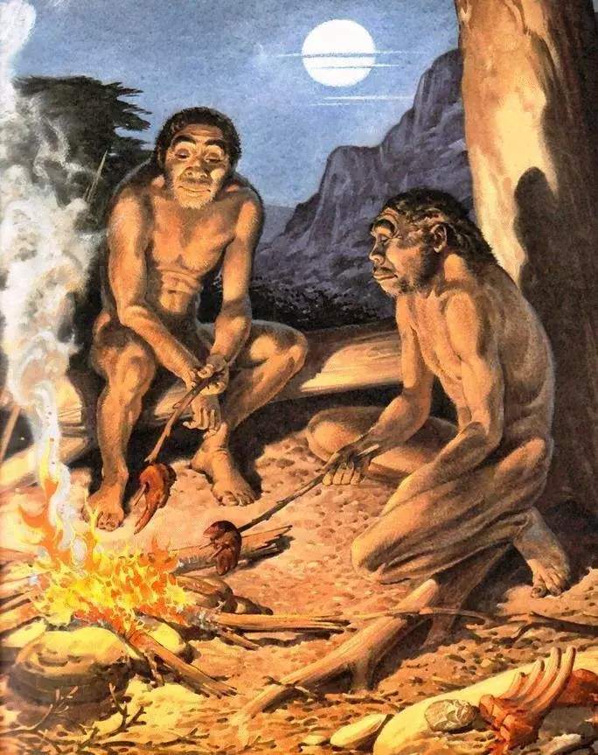
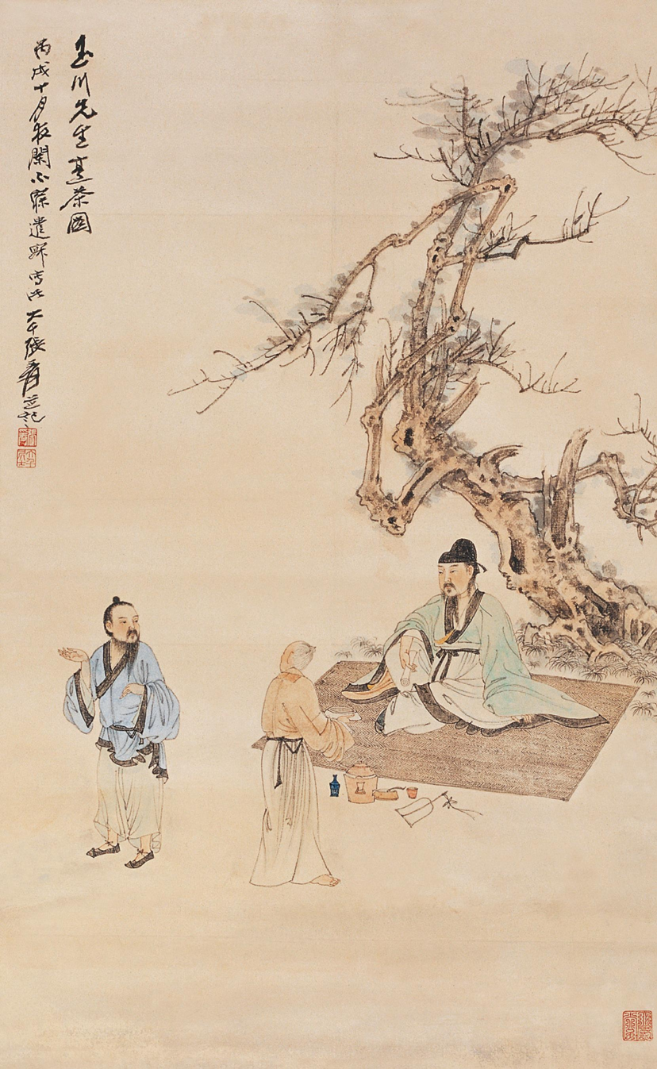
Cooking Tea
Earliest BBQ

Slide 24
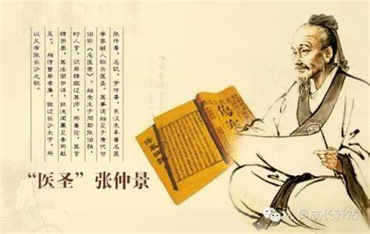
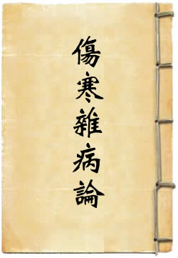
Early experience in temperature change
东汉张仲景 在《伤寒杂病论》记载外感热病

Slide 25
How to quantify the degree of the cold and hot?

Slide 26
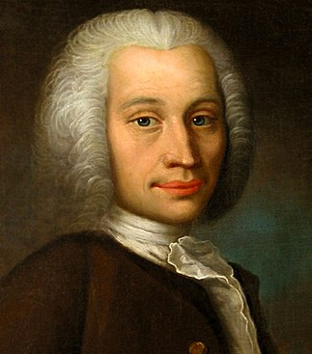
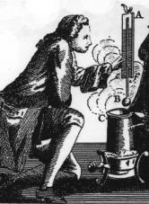
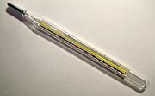
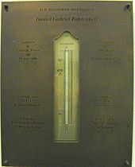
Thermometer
Celsius scale
Numerically describe the degreed of the cold and hot:
0° for the freezing point of water
100° for the boiling point of water
Anders Celsius
Swedish astronomer
(1701–1744)
Celsius was known until 1948 as centigrade
The first proposed ~1742.
Fahrenheit Scale
Proposed Mercury as a thermometric fluid.
32 °F for the freezing point of water
96 °F , as it placed in the arm or in the mouth
Memorial plaque at Fahrenheit's burial site
in the Hague
Daniel G. Fahrenheit
Dutch Physicist
(1701-1736)

Slide 27
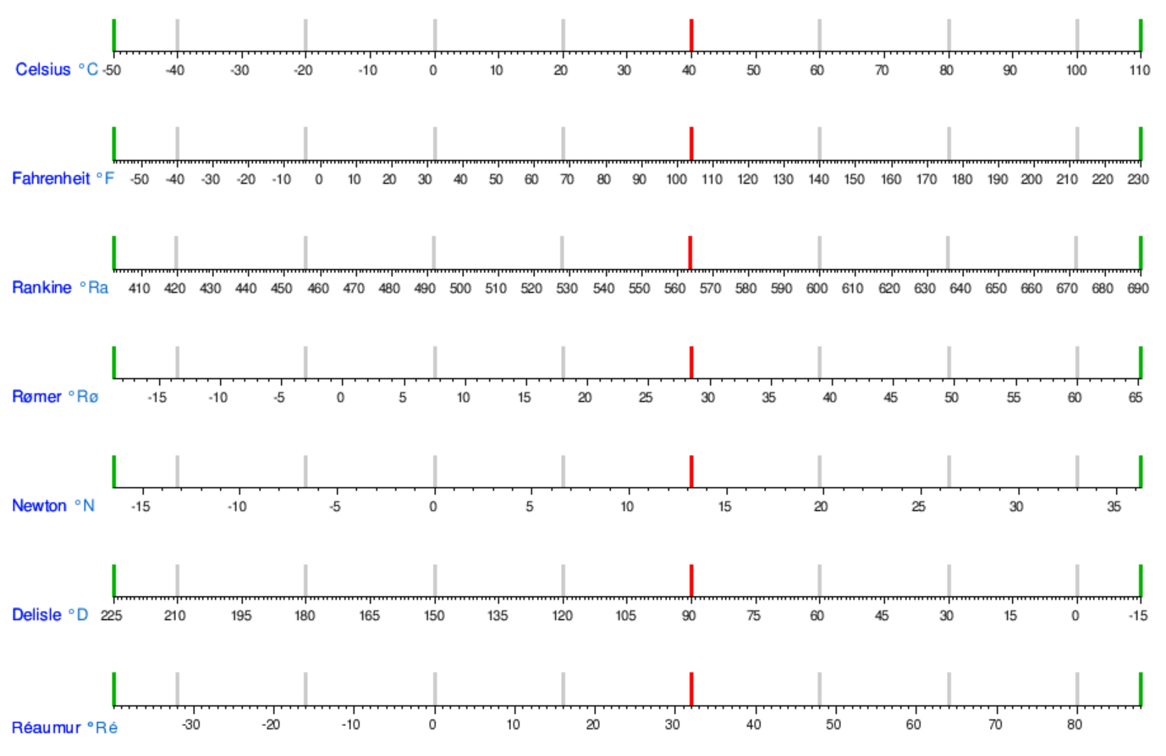
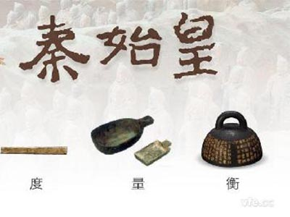
Thermometer
Any thermometer
in the history of China?

Slide 28
Thermometer
Any thermometer
in the history of China?

Slide 29
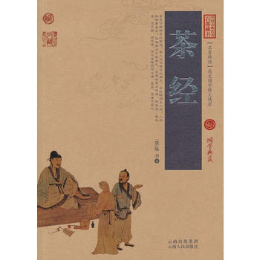
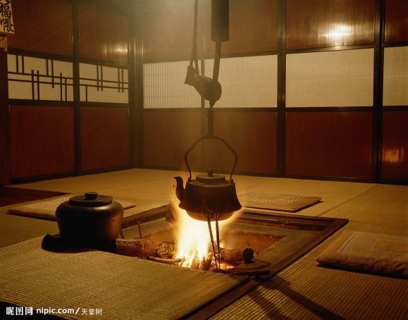
We have the chance to define a thermometer!
陆羽（733—804），字鸿渐，复州竟陵（今湖北天门）人。
一名疾，字季疵，号竟陵子、桑苎翁、东冈子，又号“茶山御史” 。
唐代著名的茶学家，被誉为“茶仙”，尊为“茶圣”，祀为“茶神”
其沸，
如鱼目，微有声，为一沸；
缘边如涌泉连珠，为二沸；
腾波鼓浪，为三沸，
已上，水老，不可食也
The define thermometer open the door to discover the mater word !

Slide 30
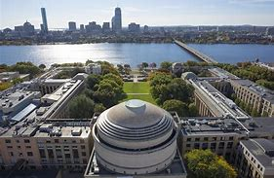
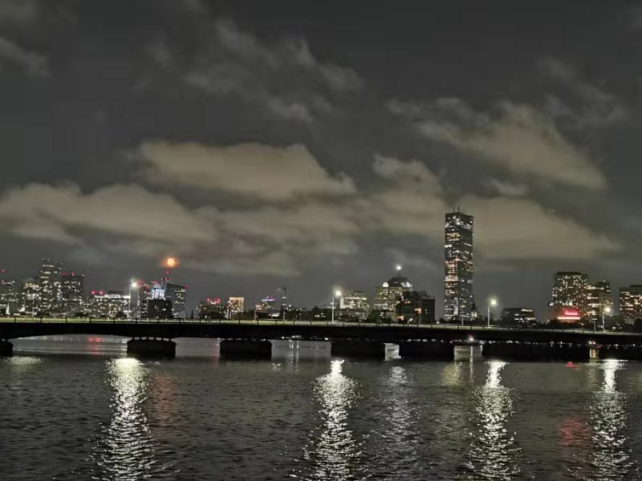
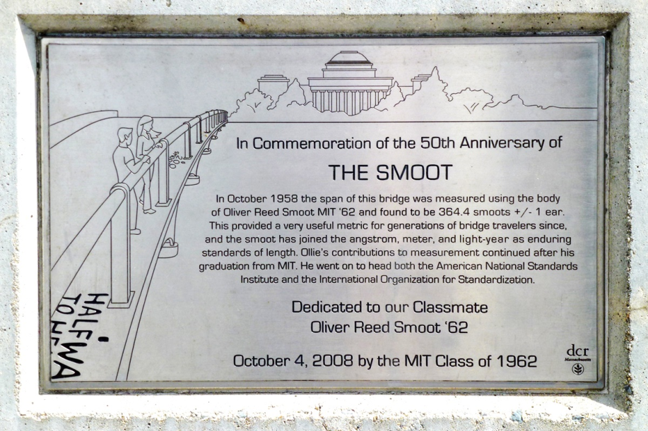
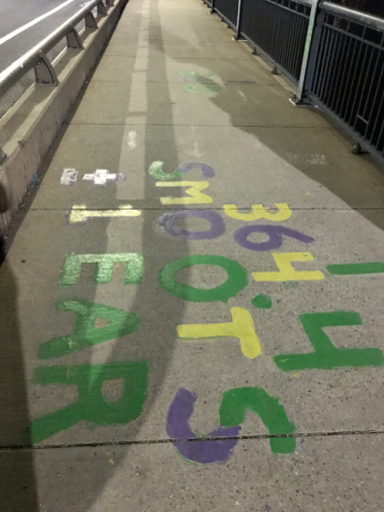
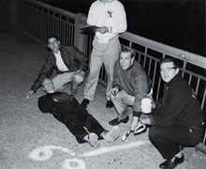
Define a your thermometer
Oliver Smoot
graduated from MIT with the class of 1962, became a lawyer, and later became chairman of the American National Standards Institute (ANSI, 2001–02) and then, president of the International Organization for Standardization (ISO, 2003–04)

Slide 31
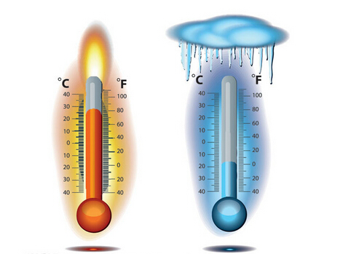
What is important things
behind a thermometer
……
……
…..

Slide 32
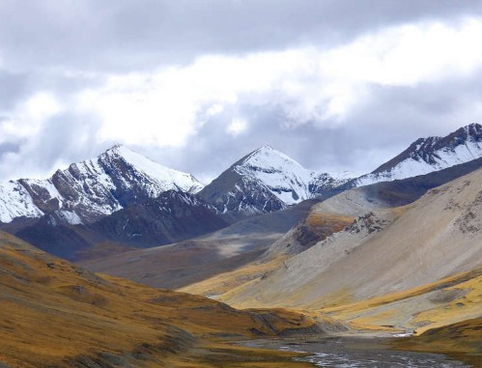
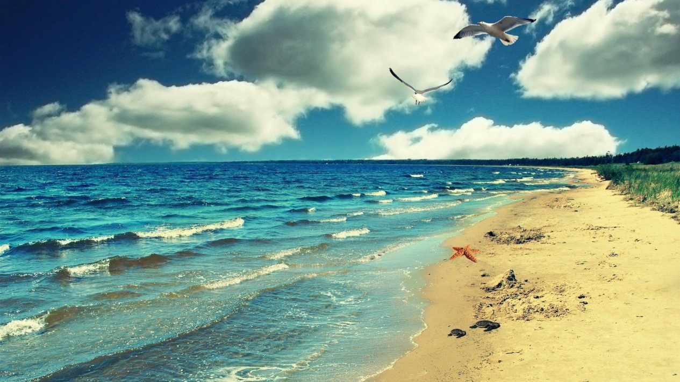
Effect of Pressure

Slide 33
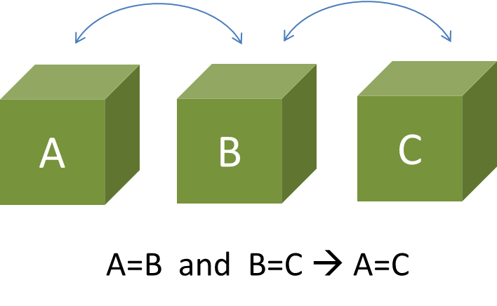
Zeroth Law of thermodynamics
If object/system A is in thermal equilibrium with object / system B,
and object/system B is in thermal equilibrium with object/system C,
then object/system C is also in thermal equilibrium with object/system A.
The physical meaning is expressed by Maxwell in the words: "All heat is of the same kind"
This law allows us to build thermometers.

Slide 34




Temperature scale
Experience temperature scale
Constant pressure thermometer
Constant volume thermometer
$$\frac{t_{P}}{100}=\frac{v−v_{0}}{v_{1}−v_{0}}$$
$$\frac{t_{v}}{100}=\frac{p−p0}{p_{1}−p_{0}}$$
v0, volume at ice point,
V1, volume at boiling point
p0, pressure at ice point,
p1,pressure at boiling point
Absolute thermodynamic temperature scale
$$T=t+T_{0}$$
The temperature measured by the constant volume thermometer and constant pressure thermometer is the same,
by the Boyle relation, i.e. pV=C.
$t=\lim_{p_{0}→0}$ $t_{p}$= $\lim_{p_{0}→0}$ $t_{v}$
Notes:
He proposed the Celsius temperature scale in a paper to the Royal Society of Sciences in Uppsala, the oldest Swedish scientific society, founded in 1710. His thermometer was calibrated with a value of 100° for the freezing point of water and 0° for the boiling point. In 1745, a year after Celsius's death, the scale was reversed by Carl Linnaeus to facilitate more practical measurement.^{[6]} Celsius originally called his scale centigrade derived from the Latin for "hundred steps". For years it was simply referred to as the Swedish thermometer.

Slide 35



Solution
Boyle relation, i.e. pV=C.
(1)
At a special scale
pV= θ
(3)
C is temperature dependent, C=F (θ)
where θ is temperature scale.
At the ice point, temperature is θ₀
At the boiling point, temperature is θ₁
pV= F (θ)
(2)
For constant pressure thermometer
For constant volume thermometer
p₀V₀= θ₀
p₀V₁= θ₁
p₀V= θ
(4)
p₀V₀= θ₀
p₁V₀= θ₁
pV₀= θ
(6)
$\frac{t_{P}}{100}=\frac{v−v_{0}}{v_{1}−v_{0}}$= $\frac{p0(v−v_{0})}{p0(v_{1}−v_{0})}=\frac{θ−θ_{0}}{θ_{1}−θ_{0}}$
(7)
(5)
$\frac{t_{v}}{100}=\frac{p−p_{0}}{p_{1}−p_{0}}$= $\frac{v0(p−p)}{v0(p_{1}−p_{0})}=\frac{θ−θ_{0}}{θ_{1}−θ_{0}}$
Comparing Eq. (5) and Eq. (7)
${tp=t}_{v}$=t
(8)

Slide 36








State equation of gas
$\frac{t_{P}}{100}=\frac{v−v_{0}}{v_{1}−v_{0}}$= $\frac{p0(v−v_{0})}{p0(v_{1}−v_{0})}=\frac{θ−θ_{0}}{θ_{1}−θ_{0}}$
1662, Boyle relation, i.e. pV=C.
(5)
$\frac{t_{v}}{100}=\frac{p−p_{0}}{p_{1}−p_{0}}$= $\frac{v0(p−p)}{v0(p_{1}−p_{0})}=\frac{θ−θ_{0}}{θ_{1}−θ_{0}}$
pV= $θ_{0}$(1+at)
(7)
${tp=t}_{v}$=t
(8)
For V=const., p linearly increase with t
For p=const., V linearly increase with t
For simple define constant a,
$θ_{1}−θ_{0}$=100 $θ_{0}$a
Experimental observations:
1787, Jacques Charles
1802, Joseph L. Gay-Lussac
Substitute back to the eq.(5) and eq. (7)
$θ=θ_{0}$(1+at_{p})
$θ=θ_{0}$(1+at_{v})
Later, ${experiments shows that tp=t}_{v}$ is just proximate valid.
The Boyle relation, i.e. pV=C is only valid as P is enough small.
Idea gas: the gas completely following the Boyle relation,
$$t=\lim_{p_{0}→0}t_{p}{=\lim_{p_{0}→0}t_{v}}$$
(9)

Slide 37
Home work
1. To mixing two cup of water with same mass, one 100 oC while other is 0 ºC, what the temperature you could really get? Discussion the factors, you need take into account, to obtain accurate result.
2. Whether the temperature scale should be uniform or not? Please do derivation considering the thermal expansion δl/l ~ const.

Slide 38
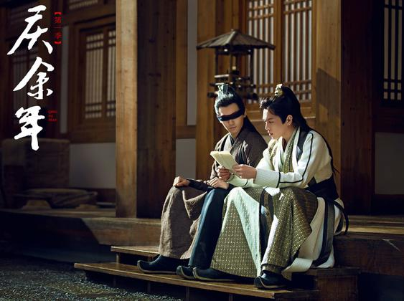
Open question
The importance of thermometer?
Imagine if you could transfer to the a Tang dynast or Song dynast, How could you using a thermometer to change the history？

